Slide 1
Image Segmentation 图像分割
彭小江，博士，副教授
深圳技术大学
邮箱: pengxiaojiang@sztu.edu.cn
主页: https://pengxj.github.io/

Slide 2
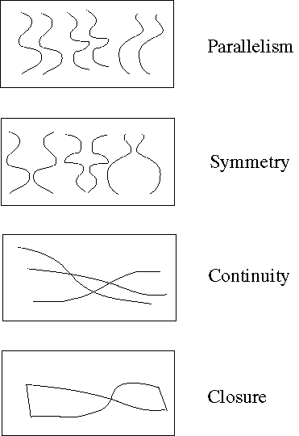
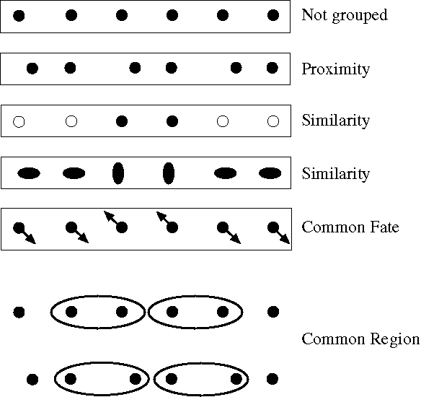
什么是图像分割？
将图像划分为多个组或者块

Slide 3




















Thresholding
Machine
Learning
based
methods
Region based
methods
(region
growing,..)
Image Segmentation Methods
Energy minimization methods (MRF,..)
Clustering (k-means, mean shift,..)
Shape based methods (level set, active contours)
Graph-based methods (graph-cut, random walk,…)

Slide 4
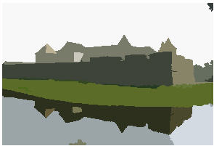
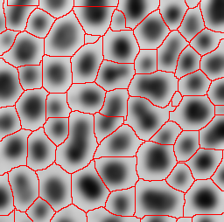
本章内容
阈值分割、区域生长分割
分水岭分割
基于聚类的分割
基于图的分割

Slide 5
阈值分割法
阈值分割法的基本思想：
确定一个合适的阈值T（阈值选定的好坏是此方法成败的关键）。
将大于等于阈值的像素作为物体或背景，生成一个二值图像。
If f(x,y) ≥ T set 255
Else set 0
在四邻域中有背景的像素，即是边界像素。
0
0
255
0
255
255
255
255
255

Slide 6
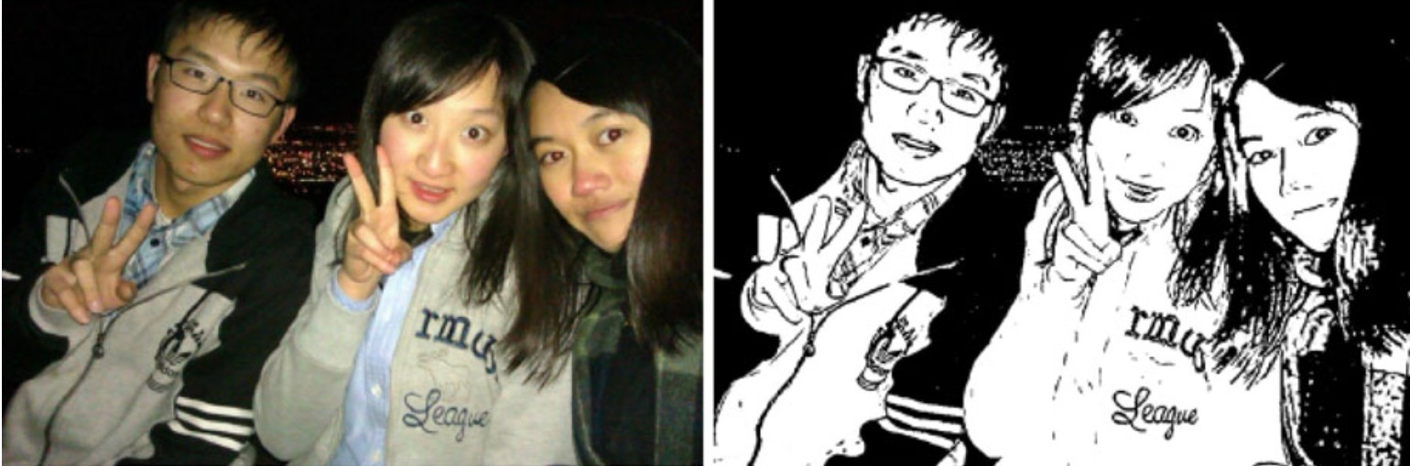
阈值分割法
阈值分割法的特点：
适用于物体与背景有较强对比的情况，重要的是背景或物体的灰度比较单一。（可通过先求背景，然后求反得到物体）
灰度值
f(x₀,y₀)
T

Slide 7
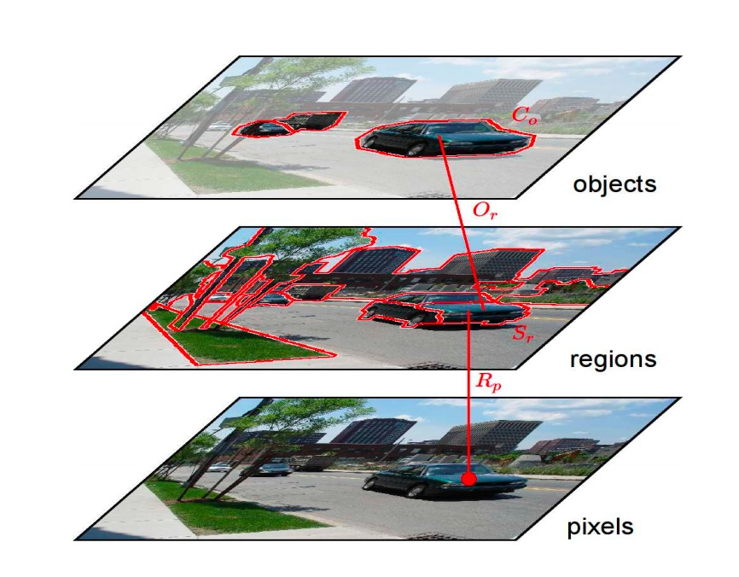
Region Based Segmentation-Basics
Region:
A group of connected pixels with similar properties
Closed boundaries
Computation of regions is based on similarity
Regions may correspond to Objects in a scene or parts of objects
Neighborhood in Spatial + similarity

Slide 8
Region Growing （区域生长法）
For segment generation in grey-level or color images, we may start at one seed pixel (x,y,I(x,y))
add recursively adjacent pixels that satisfy a “similarity criterion” with pixels contained in the so-far grown region around the seed pixel.

Slide 9
Region Growing （区域生长法）
Defining similarity criteria alone is not an effective basis for segmentation
It is necessary to consider the adjacency
spatial relationship between pixels

Slide 10
Region Growing （区域生长法）
The absolute intensity difference between candidate pixel and the seed pixel must lie within a specified range
The absolute intensity difference between a candidate pixel and the running average intensity of the growing region must lie within a specified range;
The difference between the standard deviation in intensity over a specified local neighborhood of the candidate pixel and that over a local neighborhood of the candidate pixel must (or must not) exceed a certain threshold

Slide 11
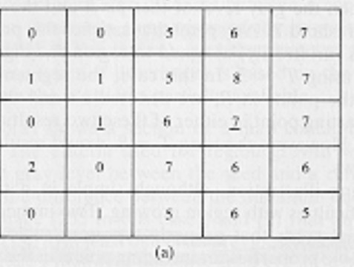
Seeded Segmentation (Region Growing)
1. Choose the seed pixel

Slide 12
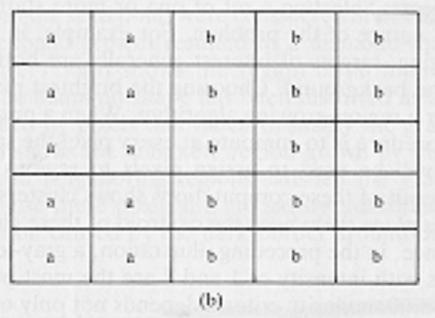
Seeded Segmentation (Region Growing)
Choose the seed pixel
Check the neighboring pixels and add them to the region if they are similar to the seed

Slide 13
Seeded Segmentation (Region Growing)
Choose the seed pixel
Check the neighboring pixels and add them to the region if they are similar to the seed
Repeat step 2 for each of the newly added pixels; stop if no more pixels can be added
28
neighboring pixels - seed| < Threshold

Slide 14
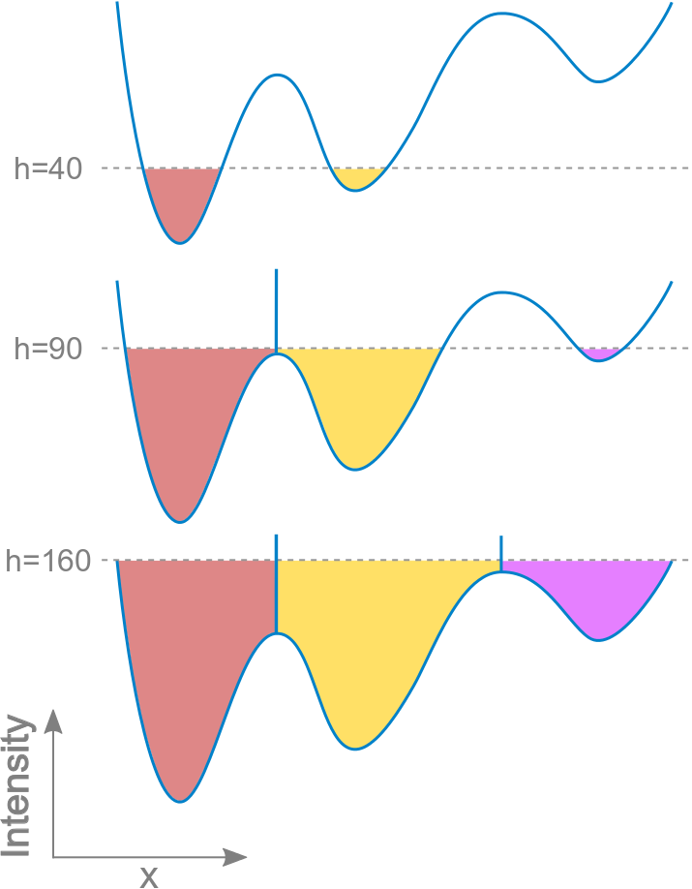
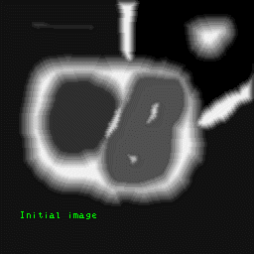
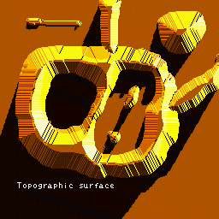
分水岭分割算法
一种和阈值分割相关的方法：把图像看成是一个拓扑地形图，通过往集水盆注水得到不同的分割区域，不同部分的交界处标记为脊
L.Vincent, P Soille. Watersheds in digital space: An efficientalgorithms based on immersion simulation[J]. IEEE Trans. on Pattern Analysisand Machine Intelligence, 1991, 13(6): 583-598.

Slide 15
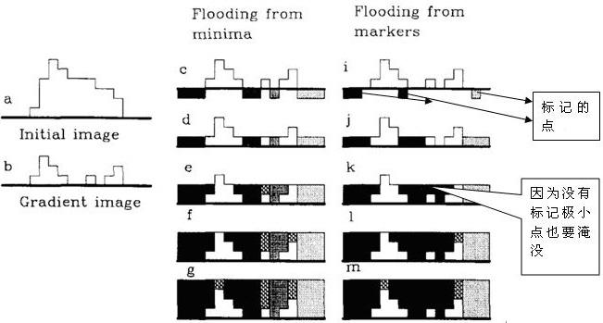
分水岭分割算法
由于图像很少有被高亮的脊分开的暗色区域，所以一般使用平滑的梯度幅度图像做
？？？
不同的水柱代表不同的组
带有标记为同一组的marker，将视为同组

Slide 16
分水岭分割算法
由于图像很少有被高亮的脊分开的暗色区域，所以一般使用平滑的梯度幅度图像或者距离变换图像做
一般步骤：
1.图像像素值找到局部最小像素值点/给定一些种子点/确定的前景点
2.对这些确定的点打上不同的标签
3.灌水，更新邻域标签，当两个不同标签像素相遇就会构建堤坝作为边界，直到所有山峰掩模，最后得到的边界对象值是-1

Slide 17
分水岭分割算法在硬币分割的应用
二值化
距离函数->二值化选取前景种子点
打标
灌水
标注边界

Slide 18
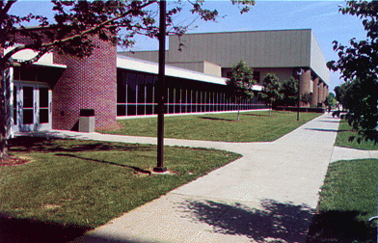
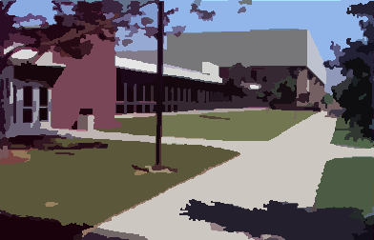
基于聚类的分割
均值漂移算法（Meanshift）

Slide 19
基本原理
Region of
interest
Center of
mass
Mean Shift
vector
Objective : Find the densest region
Distribution of identical billiard balls
Notes:
首先随便选择一个中心点，然后计算该中心点一定范围之内所有点到中心点的距离向量的平均值，计算该平均值得到一个偏移均值，然后将中心点移动到偏移均值位置，通过这种不断重复的移动，可以使中心点逐步逼近到最佳位置。

Slide 20
基本原理
Region of
interest
Center of
mass
Mean Shift
vector
Objective : Find the densest region
Distribution of identical billiard balls

Slide 21
基本原理
Region of
interest
Center of
mass
Mean Shift
vector
Objective : Find the densest region
Distribution of identical billiard balls

Slide 22
基本原理
Region of
interest
Center of
mass
Mean Shift
vector
Objective : Find the densest region
Distribution of identical billiard balls

Slide 23
基本原理
Region of
interest
Center of
mass
Mean Shift
vector
Objective : Find the densest region
Distribution of identical billiard balls

Slide 24
基本原理
Region of
interest
Center of
mass
Mean Shift
vector
Objective : Find the densest region
Distribution of identical billiard balls

Slide 25
基本原理
Region of
interest
Center of
mass
Objective : Find the densest region
Distribution of identical billiard balls

Slide 26
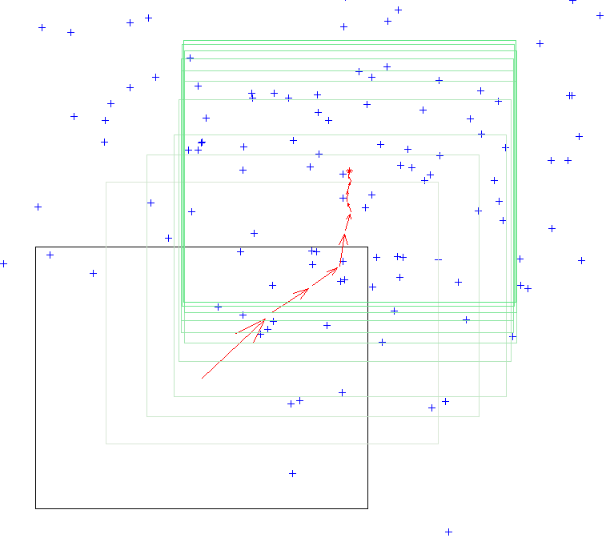
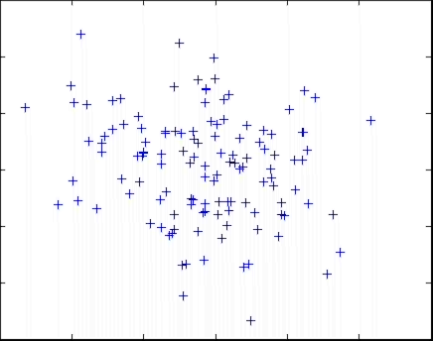
Mean Shift Algorithm
Choose a search window size.
Choose the initial location of the search window.
Compute the mean location (centroid of the data) in the search window.
Center the search window at the mean location computed in Step 3.
Repeat Steps 3 and 4 until convergence.
The mean shift algorithm seeks the “mode” or point of highest density of a data distribution:

Slide 27
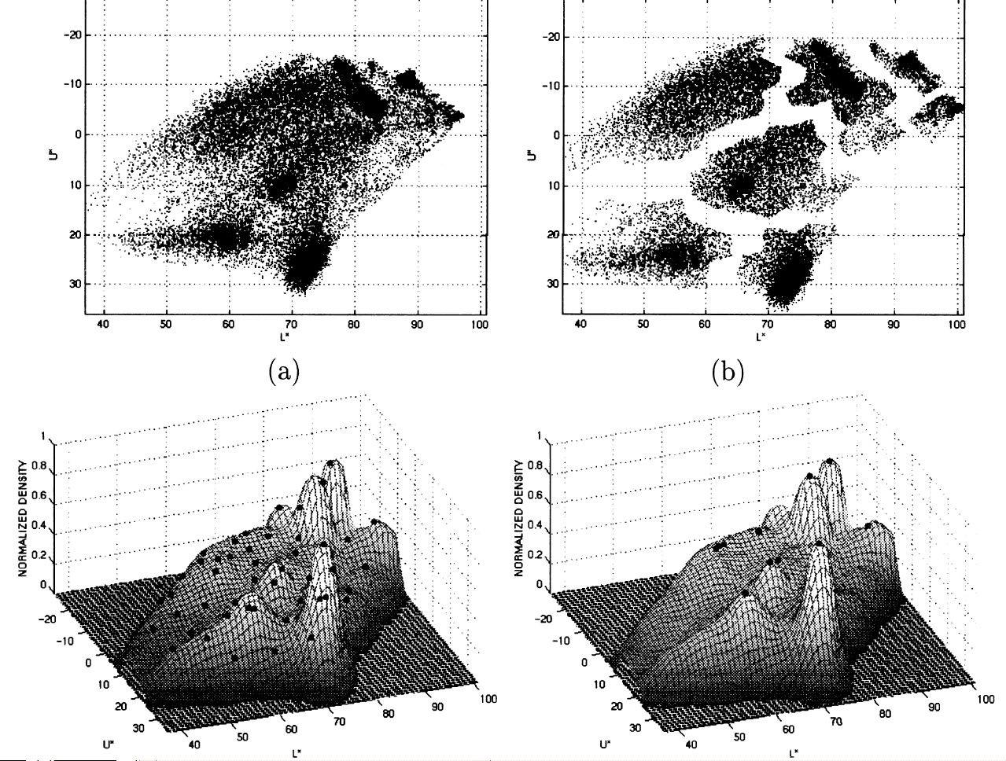
Mean Shift Segmentation
Convert the image into tokens (via color, gradients, texture measures etc).
Choose initial search window locations uniformly in the data.
Compute the mean shift window location for each initial position.
Merge windows that end up on the same “peak” or mode.
The data these merged windows traversed are clustered together.
*Image From: Dorin Comaniciu and Peter Meer, Distribution Free Decomposition of Multivariate Data, Pattern Analysis & Applications (1999)2:22–30

Slide 28
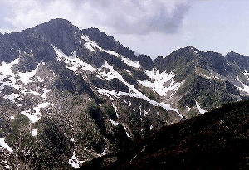
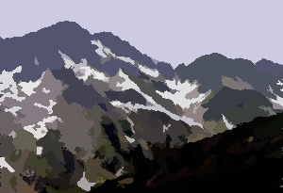
http://www.caip.rutgers.edu/~comanici/MSPAMI/msPamiResults.html

Slide 29
Segmentation by Energy Minimization: Graph Cuts

Slide 30
Graph theoretic clustering
Represent tokens (which are associated with each pixel) using a weighted graph.
affinity matrix (p_{i} same as p_{j} => affinity of 1)
Cut up this graph to get subgraphs with strong interior links and weaker exterior links
Application to vision originated with Prof. Malik at Berkeley

Slide 31
Graphs Representations
a
b
c
e
d
Adjacency Matrix: W
* From Khurram Hassan-Shafique CAP5415 Computer Vision 2003

Slide 32
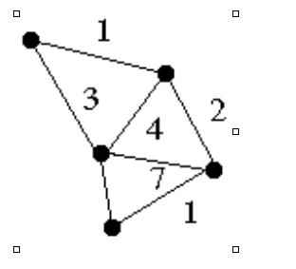
Weighted Graphs and Their Representations
a
b
c
e
6
d
Weight Matrix: W
Weight = |A-B|
* From Khurram Hassan-Shafique CAP5415 Computer Vision 2003

Slide 33
Minimum Cut （Min Cut）
A cut of a graph G is the set of
edges S such that removal of
S from G disconnects G.
Minimum cut is the cut of minimum weight, where weight of cut <A,B> is given as
* From Khurram Hassan-Shafique CAP5415 Computer Vision 2003

Slide 34

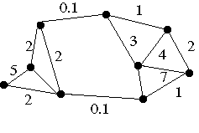
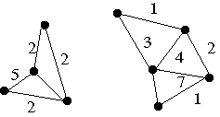
Minimum Cut and Clustering
* From Khurram Hassan-Shafique CAP5415 Computer Vision 2003

Slide 35
Image Segmentation & Minimum Cut
Pixel
Neighborhood
Image
Pixels
w
Similarity
Measure
Minimum
Cut
* From Khurram Hassan-Shafique CAP5415 Computer Vision 2003

Slide 36
Minimum Cut
There can be more than one minimum cut in a given graph
All minimum cuts of a graph can be found in polynomial time¹.
¹H. Nagamochi, K. Nishimura and T. Ibaraki, “Computing all small cuts in an undirected network. SIAM J. Discrete Math. 10 (1997) 469-481.
* From Khurram Hassan-Shafique CAP5415 Computer Vision 2003

Slide 37
Drawbacks of Minimum Cut
Weight of cut is directly proportional to the number of edges in the cut.
Cuts with
lesser weight
than the
ideal cut
Ideal Cut
* Slide from Khurram Hassan-Shafique CAP5415 Computer Vision 2003

Slide 38
Normalized Cuts¹
Normalized cut is defined as
N_{cut}(A,B) is the measure of dissimilarity of sets A and B.
Minimizing N_{cut}(A,B) maximizes a measure of similarity within the sets A and B
¹J. Shi and J. Malik, “Normalized Cuts & Image Segmentation,” IEEE Trans. of PAMI, Aug 2000.
* Slide from Khurram Hassan-Shafique CAP5415 Computer Vision 2003

Slide 39





GrabCut
Interactive Foreground Extraction using Iterated Graph Cuts
Carsten Rother Vladimir Kolmogorov Andrew Blake
Microsoft Research Cambridge-UK

Slide 40
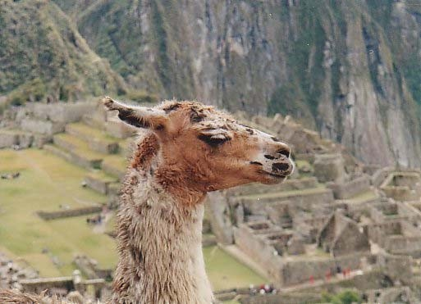
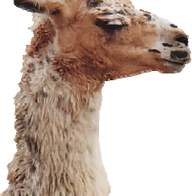
Problem
Fast & Accurate ?

Slide 41
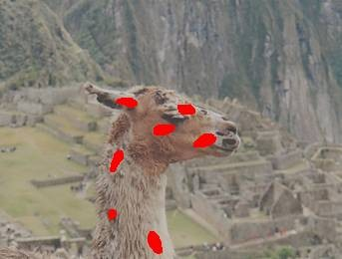
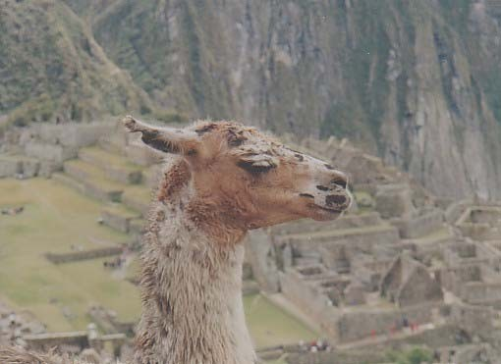

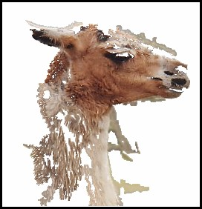
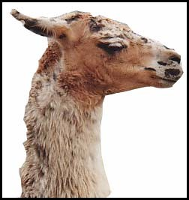
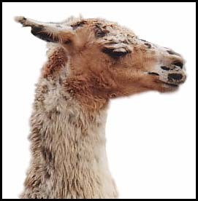
What GrabCut does
Magic Wand
(198?)
Intelligent Scissors
Mortensen and Barrett (1995)
GrabCut
User Input
Result
Regions
Boundary
Regions & Boundary

Slide 42









Framework
Input: Image
Output: Segmentation
Parameters: Colour
,Coherence
Energy:
Optimization:

Slide 43
Graph Cuts
Boykov and Jolly (2001)
Foreground (source)
Image
Min Cut
Background (sink)
Cut: separating source and sink; Energy: collection of edges
Min Cut: Global minimal enegry in polynomial time

Slide 44
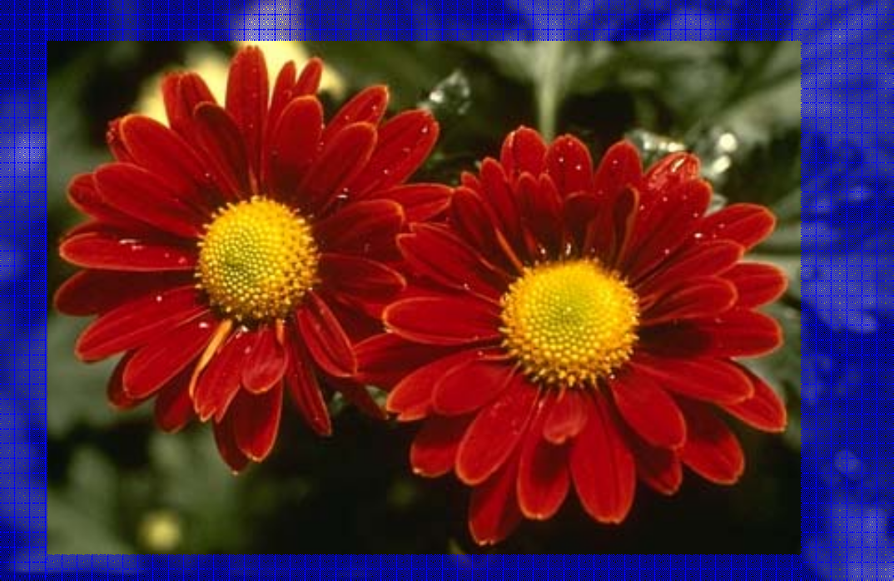


Iterated Graph Cut
?
User Initialisation
Graph cuts to infer the segmentation
K-means for learning colour distributions

Slide 45

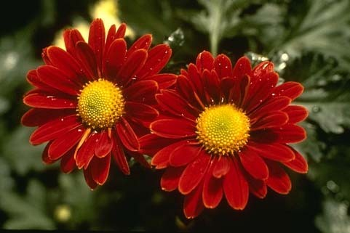

Iterated Graph Cuts
Guaranteed to
converge
1 2 3 4
Energy after each Iteration
Result

Slide 46


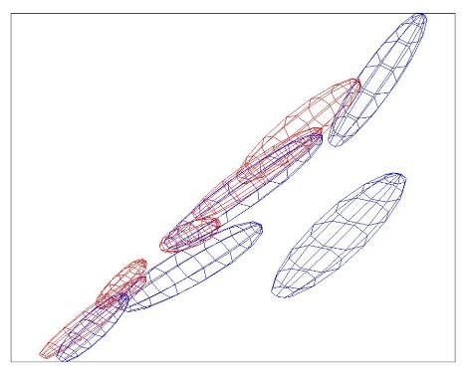
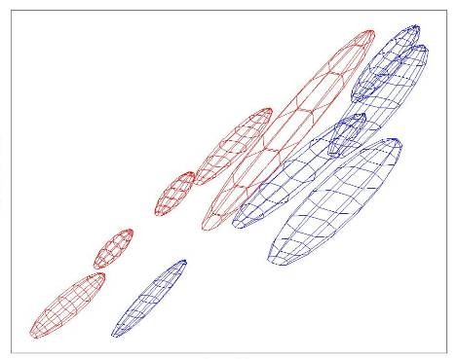

Colour Model
R
Foreground &
Background
R
Iterated graph cut
Foreground
Background G
Background
G
Gaussian Mixture Model (typically 5-8 components)

Slide 47
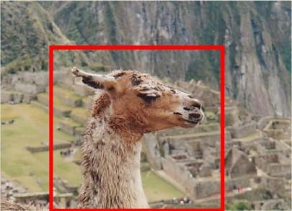


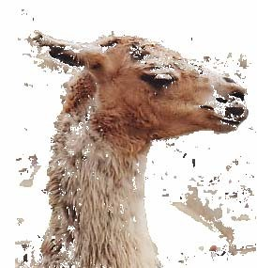
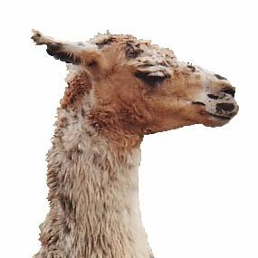
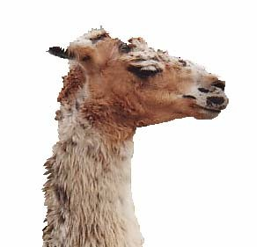




Coherence Model
An object is a coherent set of pixels:
Blake et al. (2004): Learn
jointly

Slide 48
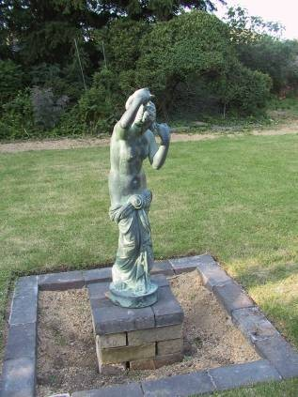
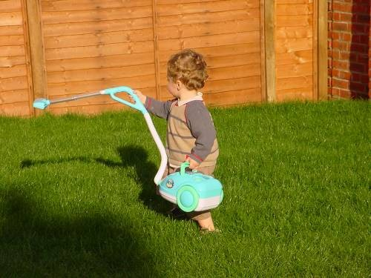
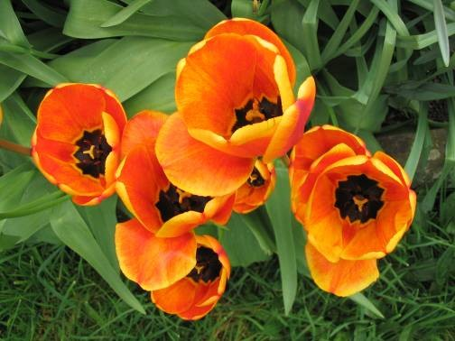



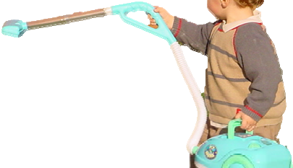



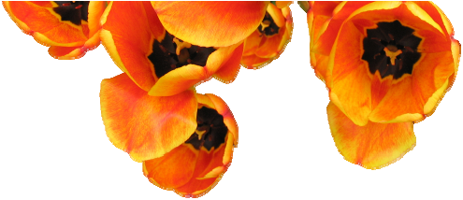

Moderately straightforward examples
… GrabCut completes automatically

Slide 49
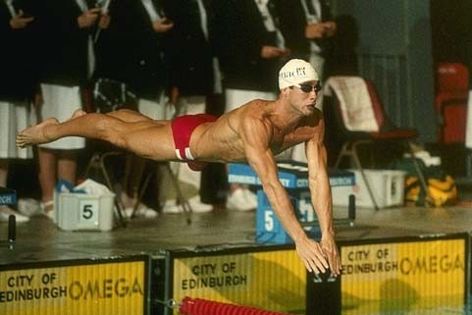
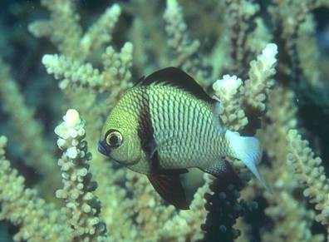
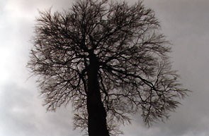
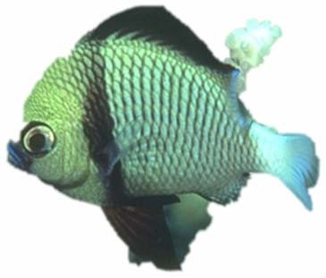
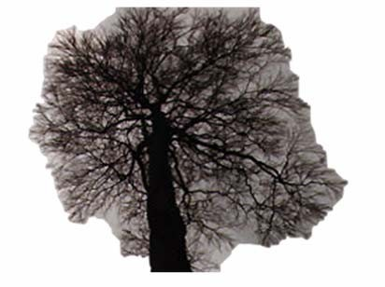



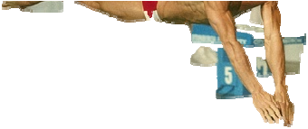
Difficult Examples
Camouflage & Low Contrast
Fine structure
No telepathy
Initial Rectangle
Initial Result

Slide 50
Ex7: 图像分割
1. Ch17:分水岭分割
2. Ch17:GrabCut交互式分割

